Slide 1
30-Day Readmission Prediction
Yuchen Huang
Chenxuan Xiong (Swaine)
Jianing Yi (Jenny)

Slide 2
Objective
We aim to develop a model that predicts whether a patient will be readmitted within 30 days, using all available patient information as input to forecast readmission likelihood.

Slide 3
Methods
1
Data Cleaning
2
EDA
Filtering and merging
30-day readmission indicator
Melting
Preliminary data and feature selection
`ZIPINC_QRTL`(Income Quartile)
ICD 10 Code
3
Modeling
4
Evaluation
Logistic Regression
Lasso Regression
Gradient Boosting Classifier
NN
Accuracy
AOC
Precision

Slide 4
Data Cleaning
1
Filtering and merging
Training: Year 2018, 2019
Test: Year 2020
Procedure: Mastoiditis, Tracheostomy
2
30-days readmission indicator
Patients whose records appeared more than once.
`NRD_DaysToEvent` less than 30 days between earlier and later visits.
3
Melting
10 diagnoses and procedures with the most significant differences
converting them into new binary indicator columns
4
Preliminary data and feature selection (Columns dropped)
Columns contain keys for identification.
Original records for diagnosis and procedure
Number of day from admission to procedure
The columns that are in 2020 and 2019 but not in 2018.

Slide 5
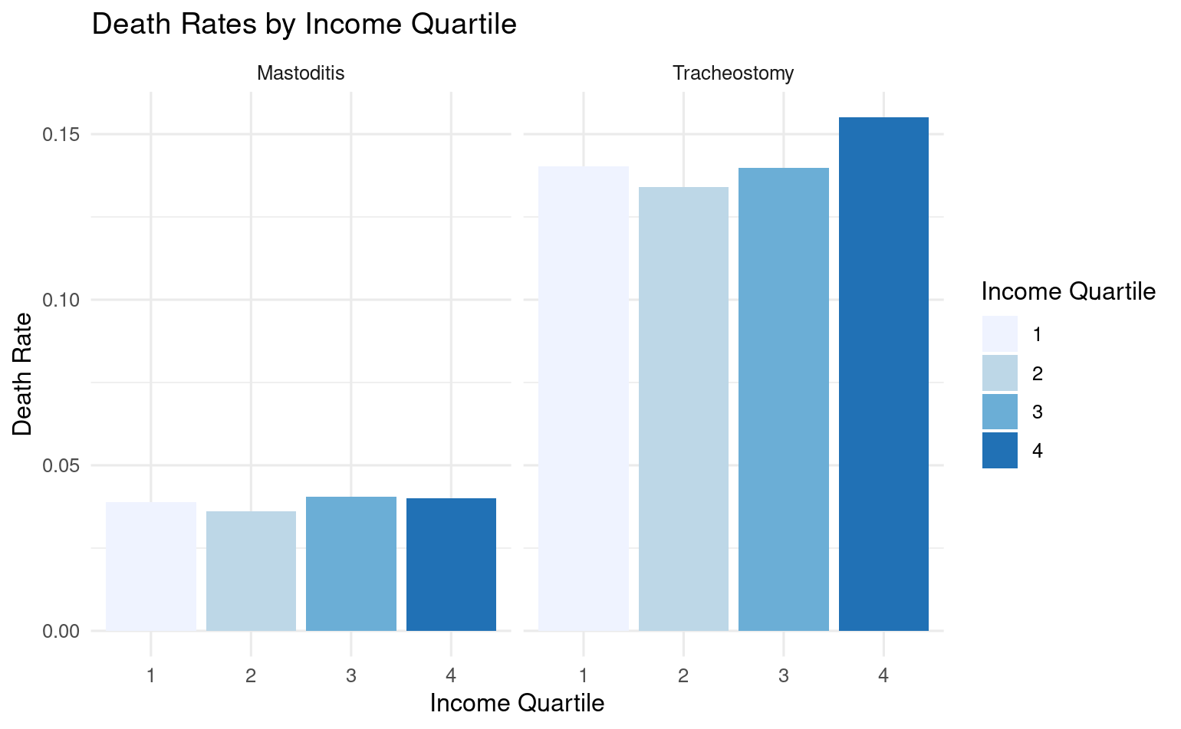
EDA

Slide 6
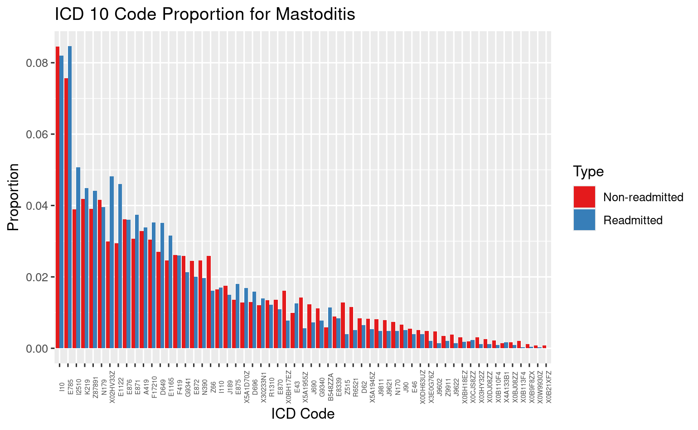
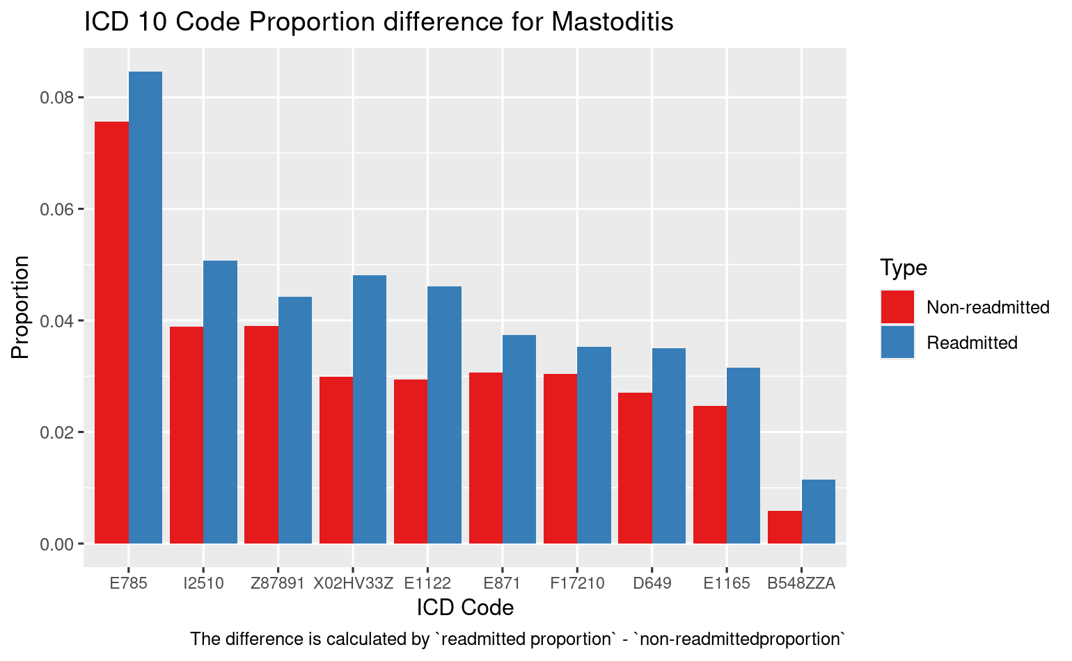

EDA

Slide 7
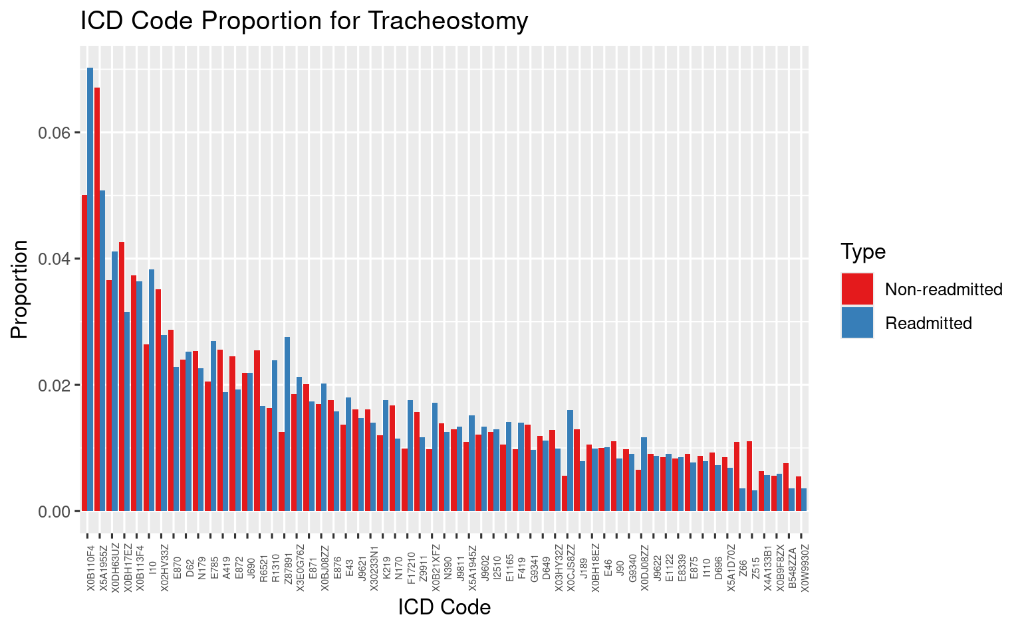
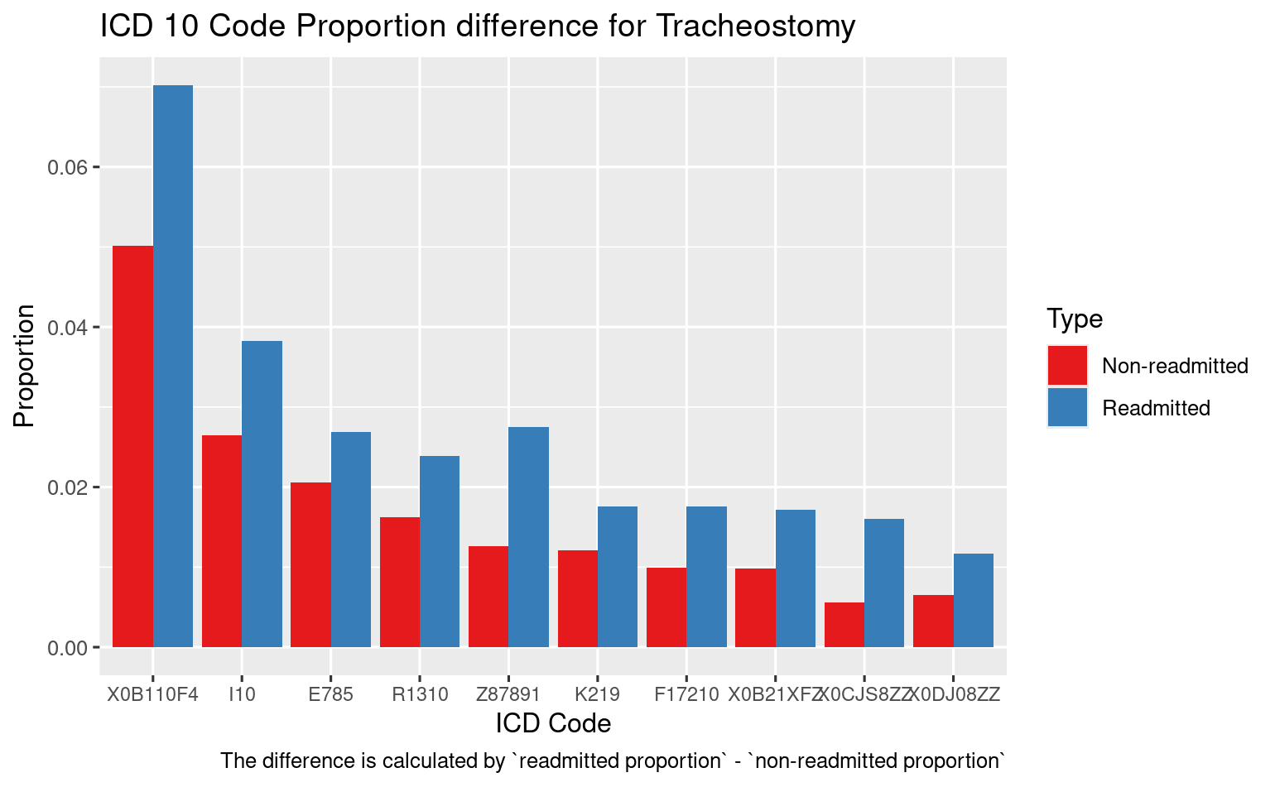
EDA

Slide 8
Model Result
Results for Mastoditis
Model | Logistic Regression | Lasso Logistic Regression | Gradient Boosting Classifier | CNN
Accuracy | 0.0847 | 0.0833 | 0.6799 | 0.9031
AUC | 0.6056 | 0.6045 | 0.6547 | 0.5819
Precision | 0.037 | 0.037 | 0.0587 | 0.0599
Results for Tracheostomy
Model | Logistic Regression | Lasso Logistic Regression | Gradient Boosting Classifier | CNN
Accuracy | 0.6719 | 0.6353 | 0.83 | 0.9730
AUC | 0.6644 | 0.6411 | 0.7369 | 0.6905
Precision | 0.00424 | 0.00391 | 0.00758 | 0.0134

Slide 9
Conclusion
Model Effectiveness:
Despite efforts, our models struggled with low accuracy and precision. However, the CNN stood out with the highest accuracy, precision, and stability.
Addressing Imbalance:
For the unbalanced dataset, the CNN is recommended. Resampling techniques, such as oversampling the minority class, could enhance model performance.
Limitations and Improvements:
Both automatic and manual feature selection were used, but residual plots suggest missing trends. Exploring causal inference methods might address these gaps and improve model outcomes.

Slide 10
Acknowledgement
We extend our heartfelt thanks to Dean and Anand for their generous contribution of HCUP data. We are truly grateful for their support.

Slide 11
Thank You

